Slide 1
Computer Networks
Socket Programming
S.V.Jansi Rani
Associate Professor / CSE
Notes:
The University of Adelaide, School of Computer Science
Chapter 2 — Instructions: Language of the Computer

Slide 2
Agenda
Basics of Socket Programming
Sequence of System calls
Sample program
Notes:
The University of Adelaide, School of Computer Science
Chapter 2 — Instructions: Language of the Computer

Slide 3



Slide 4
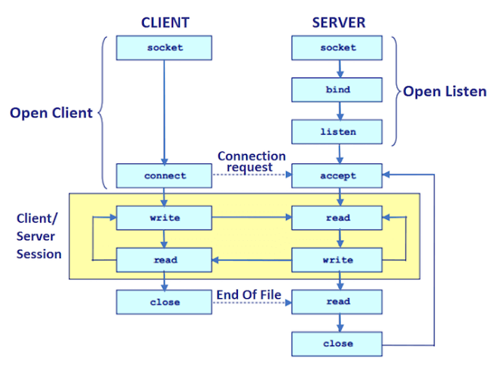
Socket API
Notes:
The University of Adelaide, School of Computer Science
Chapter 2 — Instructions: Language of the Computer

Slide 5
Internet Architecture
Defined by IETF
Three main features
  Does not imply strict layering. The application is free to bypass the defined transport layers and to directly use IP or other underlying networks
  An hour-glass shape – wide at the top, narrow in the middle and wide at the bottom. IP serves as the focal point for the architecture
  In order for a new protocol to be officially included in the architecture, there needs to be both a protocol specification and at least one (and preferably two) representative implementations of the specification
Notes:
The University of Adelaide, School of Computer Science
Chapter 2 — Instructions: Language of the Computer

Slide 6
Application Programming Interface
Interface exported by the network
Since most network protocols are implemented (those in the high protocol stack) in software and nearly all computer systems implement their network protocols as part of the operating system, when we refer to the interface “exported by the network”, we are generally referring to the interface that the OS provides to its networking subsystem
The interface is called the network Application Programming Interface (API)
Notes:
The University of Adelaide, School of Computer Science
Chapter 2 — Instructions: Language of the Computer

Slide 7
Application Programming Interface (Sockets)
Socket Interface was originally provided by the Berkeley distribution of Unix
  - Now supported in virtually all operating systems
Each protocol provides a certain set of services, and the API provides a syntax by which those services can be invoked in this particular OS
Notes:
The University of Adelaide, School of Computer Science
Chapter 2 — Instructions: Language of the Computer

Slide 8
Socket
What is a socket?
  The point where a local application process attaches to the network
  An interface between an application and the network
  An application creates the socket
The interface defines operations for
  Creating a socket
  Attaching a socket to the network
  Sending and receiving messages through the socket
  Closing the socket
Notes:
The University of Adelaide, School of Computer Science
Chapter 2 — Instructions: Language of the Computer

Slide 9
Socket
Socket Family
  PF_INET denotes the Internet family
  PF_UNIX denotes the Unix pipe facility
  PF_PACKET denotes direct access to the network interface (i.e., it bypasses the TCP/IP protocol stack)
Socket Type
  SOCK_STREAM is used to denote a byte stream
  SOCK_DGRAM is an alternative that denotes a message oriented service, such as that provided by UDP
Notes:
The University of Adelaide, School of Computer Science
Chapter 2 — Instructions: Language of the Computer

Slide 10
Creating a Socket
int sockfd = socket(address_family, type, protocol);
The socket number returned is the socket descriptor for the newly created socket
int sockfd = socket (PF_INET, SOCK_STREAM, 0);
int sockfd = socket (PF_INET, SOCK_DGRAM, 0);
The combination of PF_INET and SOCK_STREAM implies TCP
Notes:
The University of Adelaide, School of Computer Science
Chapter 2 — Instructions: Language of the Computer

Slide 11
Client-Server Model with TCP
Server
  Passive open
  Prepares to accept connection, does not actually establish a connection
Server invokes
int bind (int socket, struct sockaddr *address,
int addr_len)
int listen (int socket, int backlog)
int accept (int socket, struct sockaddr *address,
int *addr_len)
Notes:
The University of Adelaide, School of Computer Science
Chapter 2 — Instructions: Language of the Computer

Slide 12
Client-Server Model with TCP
Bind
  Binds the newly created socket to the specified address i.e. the network address of the local participant (the server)
  Address is a data structure which combines IP and port
Listen
  Defines how many connections can be pending on the specified socket
Notes:
The University of Adelaide, School of Computer Science
Chapter 2 — Instructions: Language of the Computer

Slide 13
Client-Server Model with TCP
Accept
  Carries out the passive open
  Blocking operation
    Does not return until a remote participant has established a connection
    When it does, it returns a new socket that corresponds to the new established connection and the address argument contains the remote participant’s address
Notes:
The University of Adelaide, School of Computer Science
Chapter 2 — Instructions: Language of the Computer

Slide 14
Client-Server Model with TCP
Client
  Application performs active open
  It says who it wants to communicate with
Client invokes
int connect (int socket, struct sockaddr *address,
int addr_len)
Connect
  Does not return until TCP has successfully established a connection at which application is free to begin sending data
  Address contains remote machine’s address
Notes:
The University of Adelaide, School of Computer Science
Chapter 2 — Instructions: Language of the Computer

Slide 15
Client-Server Model with TCP
In practice
  The client usually specifies only remote participant’s address and let’s the system fill in the local information
  Whereas a server usually listens for messages on a well-known port
  A client does not care which port it uses for itself, the OS simply selects an unused one
Notes:
The University of Adelaide, School of Computer Science
Chapter 2 — Instructions: Language of the Computer

Slide 16
Client-Serve Model with TCP
Once a connection is established, the application process invokes two operation
int send (int socket, char *msg, int msg_len,
int flags)
int recv (int socket, char *buff, int buff_len,
int flags)
Notes:
The University of Adelaide, School of Computer Science
Chapter 2 — Instructions: Language of the Computer

Slide 17
Example Application: Client
#include <stdio.h>
#include <sys/types.h>
#include <sys/socket.h>
#include <netinet/in.h>
#include <netdb.h>
#define SERVER_PORT 5432
#define MAX_LINE 256
int main(int argc, char * argv[])
{
FILE *fp;
struct hostent *hp;
struct sockaddr_in sin;
char *host;
char buf[MAX_LINE];
int s;
int len;
if (argc==2) {
host = argv[1];
}
else {
fprintf(stderr, "usage: simplex-talk host\n");
exit(1);
}
Notes:
The University of Adelaide, School of Computer Science
Chapter 2 — Instructions: Language of the Computer

Slide 18
Example Application: Client
/* translate host name into peer’s IP address */
hp = gethostbyname(host);
if (!hp) {
fprintf(stderr, "simplex-talk: unknown host: %s\n", host);
exit(1);
}
/* build address data structure */
bzero((char *)&sin, sizeof(sin));
sin.sin_family = AF_INET;
sin.sin_port = htons(SERVER_PORT);
/* active open */
if ((s = socket(PF_INET, SOCK_STREAM, 0)) < 0) {
perror("simplex-talk: socket");
exit(1);
}
if (connect(s, (struct sockaddr *)&sin, sizeof(sin)) < 0) {
perror("simplex-talk: connect");
close(s);
exit(1);
}
/* main loop: get and send lines of text */
while (fgets(buf, sizeof(buf), stdin)) {
buf[MAX_LINE-1] = ’\0’;
len = strlen(buf) + 1;
send(s, buf, len, 0);
}
}
Notes:
The University of Adelaide, School of Computer Science
Chapter 2 — Instructions: Language of the Computer

Slide 19
Example Application: Server
#include <stdio.h>
#include <sys/types.h>
#include <sys/socket.h>
#include <netinet/in.h>
#include <netdb.h>
#define SERVER_PORT 5432
#define MAX_PENDING 5
#define MAX_LINE 256
int main()
{
struct sockaddr_in sin;
char buf[MAX_LINE];
int len;
int s, new_s;
/* build address data structure */
bzero((char *)&sin, sizeof(sin));
sin.sin_family = AF_INET;
sin.sin_addr.s_addr = INADDR_ANY;
sin.sin_port = htons(SERVER_PORT);
/* setup passive open */
if ((s = socket(PF_INET, SOCK_STREAM, 0)) < 0) {
perror("simplex-talk: socket");
exit(1);
}
Notes:
The University of Adelaide, School of Computer Science
Chapter 2 — Instructions: Language of the Computer

Slide 20
Example Application: Server
if ((bind(s, (struct sockaddr *)&sin, sizeof(sin))) < 0) {
perror("simplex-talk: bind");
exit(1);
}
listen(s, MAX_PENDING);
/* wait for connection, then receive and print text */
while(1) {
if ((new_s = accept(s, (struct sockaddr *)&sin, &len)) < 0) {
perror("simplex-talk: accept");
exit(1);
}
while (len = recv(new_s, buf, sizeof(buf), 0))
fputs(buf, stdout);
close(new_s);
}
}
Notes:
The University of Adelaide, School of Computer Science
Chapter 2 — Instructions: Language of the Computer

Slide 22
THANK YOU

